Slide 1



Pillar Bank
May 25, 2025 @ 06:00 P.M.
Marketing Call Campaign
REPORT
Favour C. Nnadozie
Data Analyst, Pillar Bank, Portugal
1

Slide 2
OVERVIEW
This project focused on analyzing data from a direct marketing campaign carried out by Pillar bank, which involved customer outreach via phone calls. Using data analytics techniques, we aim to uncover actionable insights that can guide and optimize future marketing strategies, improve targeting, and increase campaign effectiveness.
BANK CALL CAMPAIGN STRATEGY PRESENTATION

Slide 3

Key Objectives
Conduct comprehensive exploratory data analysis to extract meaningful patterns, trends, and insights from the dataset.
Design an interactive dashboard that effectively communicates your findings to stakeholders.
BANK CALL CAMPAIGN STRATEGY PRESENTATION

Slide 4


EXECUTIVE SUMMARY
KEY CAMPAIGN METRICS.
JOB DISTRIBUTION ANALYSIS.
CAMPAIGN BY OUTCOME ANALYSIS.
AGE GROUP ANALYSIS.
CONTACT ANALYSIS.
CORRELATION ANALYSIS.
AGE GROUP VS HOUSING ANALYSIS
VOLUME OF CALL VS OUTCOME AND JOB ANALYSIS.
RECOMMENDATIONS

Slide 5

KEY CAMPAIGN METRICS.
Total Campaigns: 12,630 calls were made as part of the campaign.
Total Customers Contacted: 4,521 unique customers were reached.
Average Call Duration: Each call lasted an average of 264 seconds.
Total Loans Issued: 588 customers have an existing loan.
Overdrafts: 366 overdraft accounts were recorded.
Total Credit Balance: €6,552,439.
Total Loan Issued: €673,691.
Total Overdraft: -€120,603.

Slide 6

JOB DISTRIBUTION ANALYSIS
Distribution by Job/occupation
Most frequent occupations:
Management
Blue-Collar
Technician
Admin.
Insight:
The campaign is well-distributed across job types, but primarily targets employed individuals, particularly in managerial roles and skilled labour.
5

Slide 7
OUTCOME ANALYSIS.
Success: 2%
Failure: 7%
Other: 4%
Unknown: 87%
Insight:
The success rate is extremely low (2%), indicating that very few campaigns resulted in the desired customer action (signing up for a product/service).
87% unknown outcomes suggest a major data quality issue — either the results of most calls were not recorded or tracked properly.
Only 7% of campaigns are confirmed failures, meaning even failed calls were better documented than successful ones.
The “Other” category (4%) should be clarified.
12,630
5

Slide 8
AGE GROUP ANALYSIS.
Largest group: 29–38 years (1,775)
Followed by: 39–48 years (1,221) and then
49-58 years (895)
Insight:
The campaign mostly targeted younger to middle-aged adults - likely due to financial product eligibility or responsiveness.
5

Slide 9
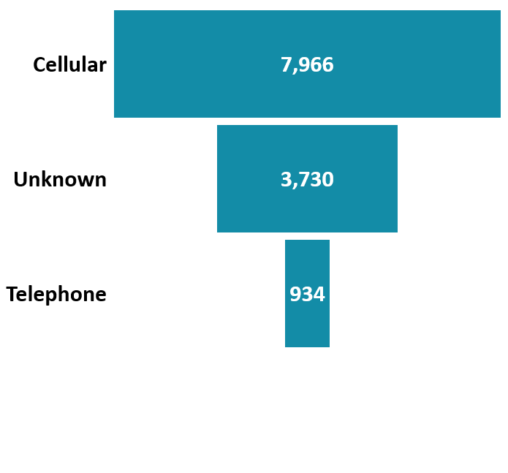
CONTACT ANALYSIS.
Insight:
Mobile phones is the primary and the dominant channel of campaign, reflecting a little bit of modern outreach preferences.
The unknown having taking the second position is a concern that must be addressed.
5

Slide 10
CORRELATION ANALYSIS.
The scatter plot shows the relationship between number of campaign calls (x-axis) and account balance (y-axis).
Observations:
Skewed Distribution: The majority of data points are concentrated in the lower range of the x-axis (campaign calls between 1 and 10). This implies there's a steep decline in account balance as the number of calls increases.
High account Balance with Few Calls: Some individuals with very high account balances (up to 70,000) received very few calls, often only 1 or 2.
This suggests that wealthier clients were either easier to reach or responded quickly, needing fewer calls.
Negative Relationship:
As the number of campaign calls increases beyond 10, the account balance remains low and negative. This simply implies that repeated calls were ineffective or targeted at less financially viable customers.
5

Slide 11
AGE GROUP VS HOUSING ANALYSIS
Here the analysis shows that the active/productive population between ages of 29-48 have landed properties (houses) but of course has low account balance with the bank and also not interested in the campaign nor taking up loan.
5

Slide 12
VOLUME OF CALL VS OUTCOME AND JOB ANALYSIS.
The analysis here sought to understand the volume of success or failure recorded with different job types for better inform decision.
The high yellow bars from the chart indicates high number of unknown outcome which questions the reliability and data quality for analysis.
5

Slide 13
Recommendations
To address low success rate the following recommendations were made:
Improve Data collection/Quality to reduce “Unknown” outcomes by ensuring strict compliance with data entry or through automated logging this will ensure accurate analysis.
Campaign and Target Refinement: Adopt a modern marketing campaign strategy by employing a professional Digital Marketer to implement modern marketing campaign such as Pay per click advertising, Social media marketing (through quality contents) and email market for a better outreach that would capture and entice the active younger population.
Strategic and well restructured message that resonate well with the modern, young, vibrant and tech-savvy population.
Rethink strategies for jobs and age groups with low success but high volume.
Use account balance and age insights to create more personalized campaign offers.
In summary, consider tailoring messaging or product offerings to the dominant age and housing segments for higher conversion potential, or explore opportunities to engage underrepresented groups.

